Slide 1
METIS DATA SCIENCE · CAPSTONE · PROJECT 05
Hacking the
Data Science
Job Description
A joint supervised + unsupervised NLP study of ~40,000 scraped Indeed postings — what language distinguishes data-science roles, and what latent structure emerges?
Garreth Cline · Metis Data Science Bootcamp Capstone
~40K postings · 150 role-token labels · 12-classifier benchmark · 18 NMF topics

Slide 2
HACKING THE DS JOB DESCRIPTION // EXECUTIVE SUMMARY
02 / 12
TL;DR
Two questions, four deliverables, one messy labor market.
THE QUESTION
THE DATA
THE MODEL
THE RESULT
Given a job description, can we predict the role tokens in its title — and what latent topics organize the corpus?
~40,000 scraped Indeed postings across 7 CSVs → ~37K after dedup. Top-150 title tokens = multi-label target.
TF-IDF descriptions (1000 features) → 12-classifier sweep → LinearSVC + GridSearchCV. NMF + KMeans for structure.
Linear models led; tuned LinearSVC reached moderate Jaccard, low Hamming — plus an interpretable role-vocabulary map.
The model's "confusion" is a faithful reflection of industry confusion. `pipeline` predicts both scientist AND engineer — because the work genuinely overlaps.
Garreth Cline · Metis Data Science · Project 5

Slide 3
HACKING THE DS JOB DESCRIPTION // THE DATA
03 / 12
~40,000 postings, scraped and stitched together
Seven CSV exports from an Indeed scrape → one unified corpus.
RAW SCRAPE
DEDUP + NULL
TOP-150 TOKENS
TF-IDF
TRAIN / TEST
40,000+
~37,000
150
1,000
80 / 20
Indeed postings
across 7 CSVs
Unique postings
title + desc
Label vocabulary
from titles
Description
features
random_state=42
Layered stopwords
Multi-label target
One-vs-Rest wrapper
NLTK English + US states & abbreviations + domain boilerplate (team, company, opportunity) forced out.
Top-150 title tokens; each posting tagged with the subset it contains — preserves multi-skill reality.
Each of 12 classifiers becomes 150 independent binary models.
Garreth Cline · Metis Data Science · Project 5

Slide 4
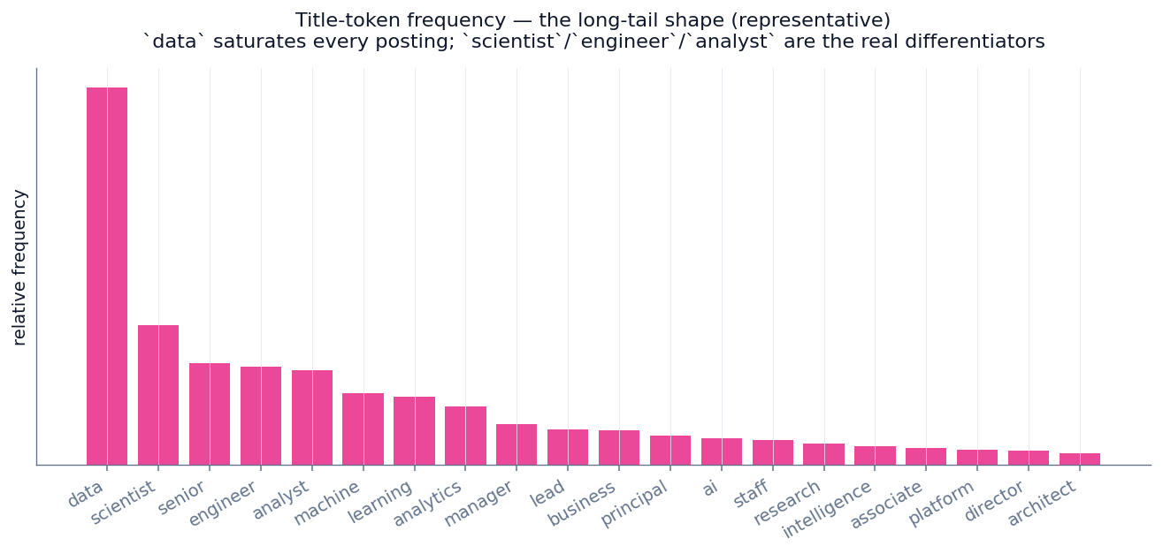
HACKING THE DS JOB DESCRIPTION // LABELS
04 / 12
Title tokens follow a long-tail shape
`data` saturates everything; scientist / engineer / analyst are the differentiators.
Reading the shape
`data` appears in almost every title — high frequency, low signal.
The second tier — scientist, engineer, analyst — carries the real role distinction.
Top-150 captures the bulk of usages; the long tail is too sparse to learn.
Garreth Cline · Metis Data Science · Project 5

Slide 5
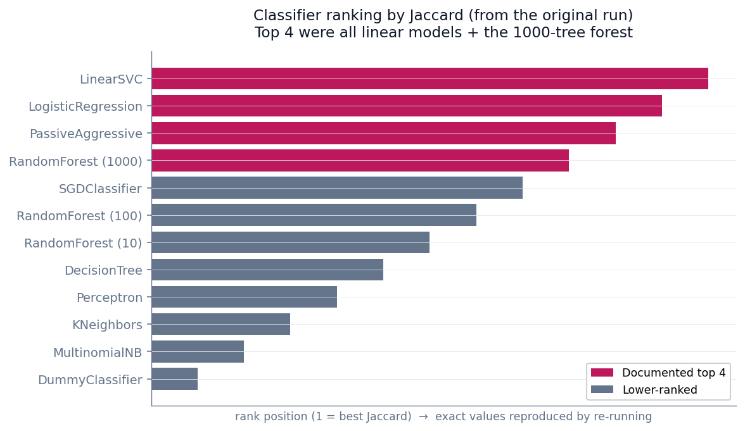
HACKING THE DS JOB DESCRIPTION // BENCHMARK
05 / 12
Linear models led the ranking
Top 4 by Jaccard were all linear models + the 1000-tree forest.
Why linear wins
Top 4: LinearSVC, LogisticRegression, PassiveAggressive, RF-1000. For sparse TF-IDF, a linear boundary fits.
Tree ensembles plateau — little interaction structure in a bag-of-words vector to exploit.
KNN and Naive Bayes trail — distance breaks down in sparse space; the independence assumption fails.
Garreth Cline · Metis Data Science · Project 5

Slide 6
HACKING THE DS JOB DESCRIPTION // RESULTS
06 / 12
Tuned LinearSVC — moderate Jaccard, low Hamming
GridSearchCV over C; the interpretability is the headline, not a single score.
JACCARD
HAMMING LOSS
ⓘ On the numbers
moderate
low
Exact Jaccard / Hamming come from the original 2021 run on the full scrape. The repo notebook reproduces the pipeline on a labeled synthetic corpus; point it at your CSVs for precise figures.
model is usually mostly-right per posting
few individual label bits wrong
Why a moderate Jaccard is the honest expectation
Title tokens are ambiguous (`engineer` = ML / data / software / analytics engineer) · descriptions share a boilerplate core (legal, benefits, EEO) · the labor market is genuinely fuzzy. Getting the exact 150-token set right is hard even when the model is mostly right per row — which is exactly what "moderate Jaccard + low Hamming" means.
Garreth Cline · Metis Data Science · Project 5

Slide 7
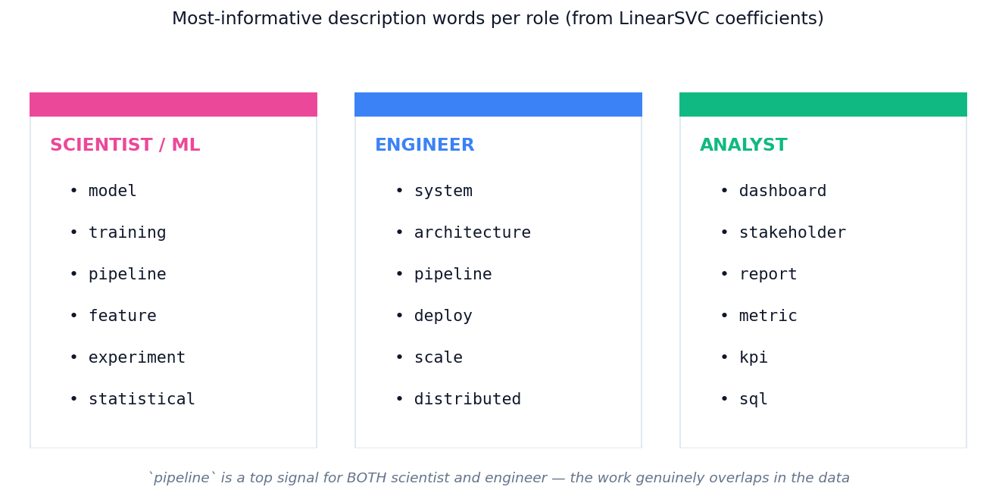
HACKING THE DS JOB DESCRIPTION // INTERPRETABILITY
07 / 12
The real payoff: role-specific vocabulary
LinearSVC coefficients → a literal resume cheat sheet.
`pipeline` is a top signal for BOTH scientist and engineer — the word is ambiguous because the work genuinely overlaps across those roles.

Slide 8
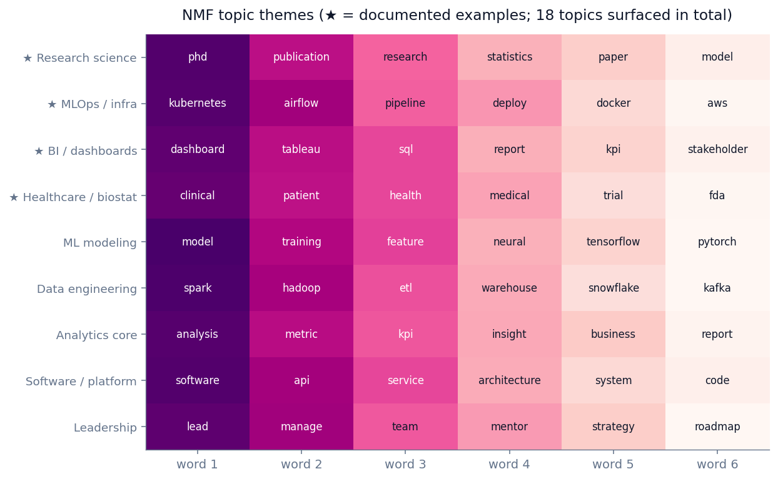
HACKING THE DS JOB DESCRIPTION // NMF TOPICS
08 / 12
18 coherent topics emerge — without labels
★ marks the four documented in the original analysis.
The validation point
An unsupervised method, given no labels, recovers structure that matches the supervised role distinctions. Documented topics: research science (phd, publication), MLOps (kubernetes, airflow), BI/dashboards, healthcare/biostatistics. That overlap between NMF topics and the classifier's role vocabulary is the real signal.
Garreth Cline · Metis Data Science · Project 5

Slide 9
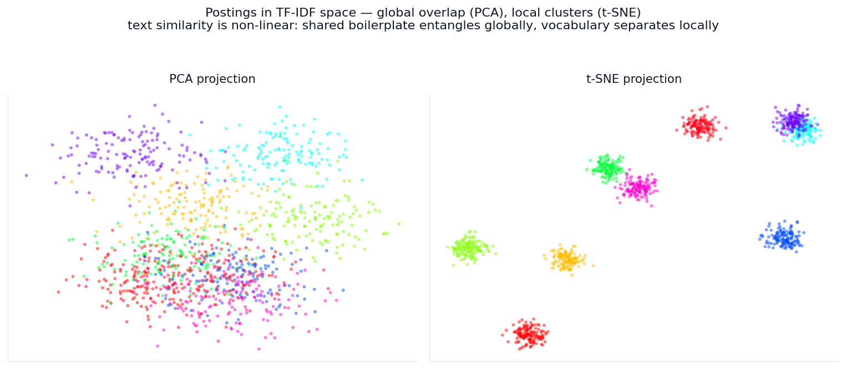
HACKING THE DS JOB DESCRIPTION // CLUSTERING & PROJECTION
09 / 12
Text similarity is non-linear
PCA shows global overlap; t-SNE reveals local cluster structure.
Postings are globally entangled (everyone uses team / company / experience) but locally well-separated by vocabulary — which is why a bag-of-words ceiling exists.

Slide 10
HACKING THE DS JOB DESCRIPTION // INTERPRETATION
10 / 12
Why the ceiling is moderate
Three structural reasons — none of them are modeling failure.
1
Title tokens are inherently ambiguous
`engineer` appears in ML, data, software, and analytics engineer — four roles, one token. A 150-label vocabulary can't disambiguate what the underlying taxonomy doesn't distinguish.
2
Descriptions share a huge boilerplate core
Legal disclaimers, benefits, EEO statements, "passionate team players." Even with layered stopwords, the signal-to-noise ratio is bounded.
3
The labor market is genuinely fuzzy
`pipeline` predicts both scientist and engineer because the work is genuinely shared. The model's confusion faithfully mirrors industry confusion.
Garreth Cline · Metis Data Science · Project 5

Slide 11
HACKING THE DS JOB DESCRIPTION // CAVEATS
11 / 12
What's limited, and where V2 goes
Honest limitations and prioritized next steps.
LIMITATIONS
FUTURE WORK
Selection bias — only postings that made it onto Indeed are observed.
Sentence-transformer embeddings (all-MiniLM-L6-v2) — handles adversarial phrasing.
Time-boxed snapshot — 2021 scrape; transformer / llm barely present then, top tokens now.
Swap K-Means for HDBSCAN — density-based, no k to pick.
TF-IDF ignores word order — "senior engineer, DS skills" = "senior DS, eng skills."
Enrich with salary data (Levels.fyi, Glassdoor) — joint classification + regression.
Bag-of-words ceiling — exact 150-token set prediction is hard even when mostly right.
Re-scrape 2026 — measure five years of vocabulary drift.
Garreth Cline · Metis Data Science · Project 5

Slide 12
HACKING THE DS JOB DESCRIPTION // BOTTOM LINE
12 / 12
The bottom line
Linear models on TF-IDF descriptions map the data-science labor market — moderate Jaccard, low Hamming, and an interpretable vocabulary that distinguishes scientist, engineer, and analyst roles.
What this demonstrates
End-to-end NLP pipeline
Scrape → clean → TF-IDF → 12-classifier sweep → GridSearch → NMF → KMeans → t-SNE.
Interpretation-first
Coefficients become a resume cheat sheet; interpretable beats black-box for this problem.
Honest about limits
Reports WHY the ceiling is moderate (taxonomy ambiguity), not an inflated number.
STACK
Python · pandas · scikit-learn · NLTK · NMF · KMeans · PCA · t-SNE · matplotlib

